Slide 1

MODELLING OF ELECTRICAL VEHICLE AND ITS SPEED & DISTANCE EVALUATION ANALYSIS USING MATLAB

Slide 2
GROUP-1
G.BHOOMIKA 2005A21023
L.UDAY KIRAN 2005A21034
G.MOHINI 2005A21035
P.SIDDHARTH 2005A21072
UNDER THE GUIDENCE OF
Dr . D. RAJA BABU
Associate Professor of Dept. EEE

Slide 3
ABSTRACT
Electric vehicles (EVs)have emerged as a promising solution to mitigate environmental concerns and reduce dependence on conventional fossil fuels. . Understanding the relationship between motor torque, vehicle velocity, and distance travelled is crucial for optimizing the performance and efficiency of EVs. This project focuses on developing a Simulink model to analyse this correlation and provide valuable insights into EV dynamics under different torque conditions.
The methodology involves the construction of a comprehensive Simulink model that integrates the electric motor system’s characteristics and vehicle dynamics. The model includes and electric motor model representing the motor’s torque- speed curve, efficiency, and other relevant parameters. Additionally, it incorporates vehicle dynamics components, considering parameters such as initial velocity, vehicle mass, rolling resistance, aerodynamic drag, and road gradient.
The results and analysis section presents the outcomes of the simulations, unveiling the intricate relationship between motor torque, vehicle velocity, and distance. The findings offer valuable insights into optimizing torque setting for enhanced EV performance, energy efficiency, and smooth operation.

Slide 4
Introduction
Electric vehicles (EVs)have emerged as a promising solution to mitigate environmental concerns and reduce dependence on conventional fossil fuels. It also represents a transformative shift in the automotive industry, aiming to address environmental concerns and reduce dependence on traditional internal combustion engine (ICE) vehicles. Unlike conventional vehicles that rely on gasoline or diesel, electric vehicles are powered by electricity stored in batteries. Understanding the relationship between motor torque, vehicle velocity, and distance travelled is crucial for optimizing the performance and efficiency of EVs. This project focuses on developing a Simulink model to analyse this correlation and provide valuable insights into EV dynamics under different torque conditions.
This project focuses on developing a Simulink model to investigate the relationship between motor torque, vehicle velocity, and distance travelled in an electric vehicle. Simulink, a powerful simulation tool from MATLAB, allows us to create a dynamic and realistic model of an EV's motor system and its interaction with the vehicle's motion.

Slide 5
OBJECTIVES
1.Model Development for Comprehensive Understanding
2. Accurate Prediction of Velocity and Distance
3.Integration of Motor Torque and Vehicle Dynamics
4.Exploration of Transient and Steady-State Behaviour
5.Identification of Optimal Operating Condition
6.Validation Against Real-World Data
7.Contribution to Electric Vehicle Research
Challenges and Advances in EV Modelling
1.Complexity of Interactions
2.Uncertainties in Parameter Values
3.Dynamic Nature of Driving Conditions
4.Temperature Effects on Battery Performance
5. Integration of Control Strategies
6. Model Validation Complexity
7. Integration of Renewable Energy Sources
8. Cybersecurity Considerations
9.Data-Driven Approaches

Slide 6
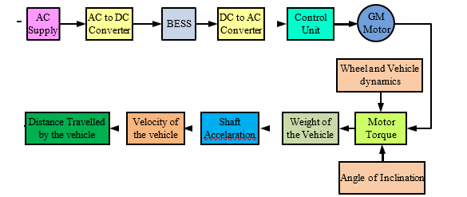
BLOCK DIAGRAM

Slide 7
MODELLING OF ELECTRICAL VEHICLE
The primary objective of this study is to design and implement a comprehensive Simulink model that encapsulates the intricate dynamics of an electric vehicle. This model aims to be a versatile tool, providing researchers, engineers, and practitioners with a platform to gain a nuanced understanding of the interactions between motor torque, vehicle dynamics, and overall performance.
Accurate Prediction of Velocity and Distance. A specific focus of this study is to develop a Simulink model capable of accurately predicting the velocity and distance travelled by an electric vehicle based on varying motor torque inputs. By achieving this objective, the model will enable researchers to explore how changes in motor torque influence the vehicle's acceleration, deceleration, and overall motion, providing valuable insights into the dynamic behaviour of electric vehicles.
Integration of Motor Torque and Vehicle Dynamics. An essential objective is the seamless integration of the electric motor model with the vehicle dynamics model within the Simulink environment. This integration ensures a holistic representation of the electric vehicle system, where motor torque not only drives acceleration but also influences the broader dynamics of the vehicle. This interconnected approach is crucial for capturing the real-world interactions within an electric vehicle.
Exploration of Transient and Steady-State Behaviour. The Simulink model is designed to explore both transient and steady-state behaviour of an electric vehicle. Transient behaviour, which encompasses rapid changes in motor torque, is essential for understanding scenarios such as acceleration during sudden manoeuvres. Steady-state analysis, focusing on constant or gradually varying torque inputs, provides insights into the sustainable performance and efficiency of the vehicle.

Slide 8
METHODOLOGY
Simulink Model Development: The Simulink model is constructed based on the fundamental principles of vehicle dynamics and the electric motor system. It consists of the following key components:
Electric Motor Model: The electric motor model represents the behaviour of the EV motor and its torque characteristics. This includes parameters like rated torque, torque-speed curve, and efficiency.
Vehicle Dynamics Model: The vehicle dynamics model takes inputs from the motor model and calculates the vehicle's acceleration, velocity, and distance travelled over time.
Power Electronics and Control: The model includes the power electronics and control circuitry to regulate the motor torque based on user inputs.
Input Parameters: The Simulink model allows users to input various parameters, such as motor torque setpoints, initial velocity, vehicle mass, rolling resistance, aerodynamic drag, and road gradient.
Simulation Scenarios: Multiple simulation scenarios are executed to analyse the impact of different torque values on the EV's velocity and distance travelled. The simulations consider varying terrain conditions, road gradients, and motor torque profiles.

Slide 9
Model calculations
Power required:
P = F x V
F= Total Force
V= Velocity of the vehicle
∑Ft = Total tractive effort of the vehicle,
ΣFr =Total resistance,
^{T}rf & Trr= Rolling resistance moment of front & rear tires
^{F}rf& Frr = Rolling resistance of front and rear tires, ^{F}tf & Ftr = Tractive effort of the front and rear tires, Fw = Aerodynamic drag,
Fg=Mg sin α = Hill climbing resistance,
M = Total mass of the vehicle,
g = Acceleration constant,
δ= Mass factor that equivalently converts the rotational inertias of rotating components into translational masss
α= Road angle

Slide 10
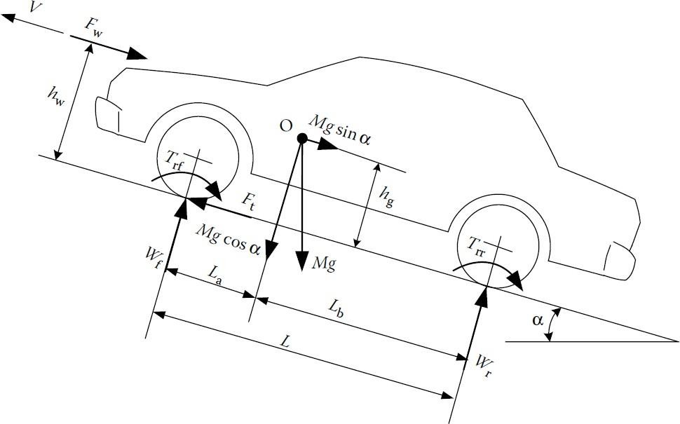
The total tractive force acting on a EV can be represented as below:
Ftrac = Faero + Fgrad + Facc + Froll
Here,
Faero = aerodynamic drag force = 0.5 * ρ * V^2 * A * Cd
where,
ρ = Air density, that is normally 1.25 kg/m^3. A = Frontal area of the vehicle in m^2
Cd = Air drag co-efficient of the vehicle (It depends on frontal area, shape, protrusions, ducts, air passage etc.)
V = Velocity of the vehicle in m/s
Fgrad = force due to gradient = m * g * sin φ
where,
m = Total mass of the vehicle (vehicle mass + payload) in kg g = Gravitational constant that is 9.8 m/s^2
φ = up gradient angle or inclination angle in radian in this case up gradient angle(φ) = 0, as there is no inclination.
Froll = force due to rolling resistance = C r r * m * g

Slide 11
where,
C r r= Rolling resistance co-efficient (It depends on the tire material, tire structure, tire temperature, road roughness, road material etc.)
m= Total mass of the vehicle(Vehicle mass+ payload) g = gravitational constant, that is 9.8 m/s^2
Facc = acceleration force = m * a
Where,
m = Total mass of the vehicle (vehicle mass + payload) in kg
a = vehicle acceleration in m/s^2
Torque & force relation Torque,
T = Ftrac * r
Where,
Ftrac = total tractive force and
r = tyre radius

Slide 12
Case study
OBJECTIVES | CASE-1 W=2000 ,N=50 | CASE-1 W=1500 ,N=50 | CASE-1 W=1000 ,N=50 | CASE-1 W=500 ,N=50
TYRE RADIUS | 3.3 | 3.3 | 3.3 | 3.3
TOTAL FORCE | 135.6 | 111.86 | 88.9 | 64.24
EFFECTIVE FORCE | 64.38 | 88.33 | 112 | 135
TORQUE | 200 | 200 | 200 | 200
ACCELERATION | 3.155 | 4.322 | 5.48 | 6.65
VELOCITY(KMHP) | 11.36 | 15.56 | 19.76 | 23.96
DISTANCE TRAVELLED (KM) | 0.015 | 0.0216 | 0.027 | 0.033

Slide 13
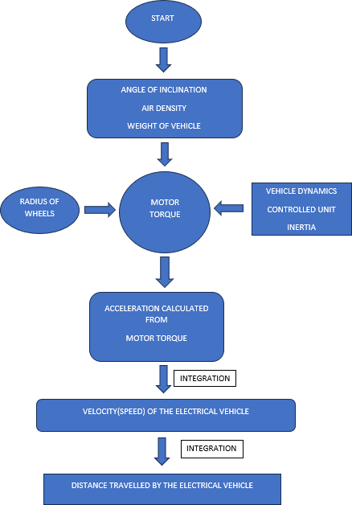
FLOW CHART

Slide 14
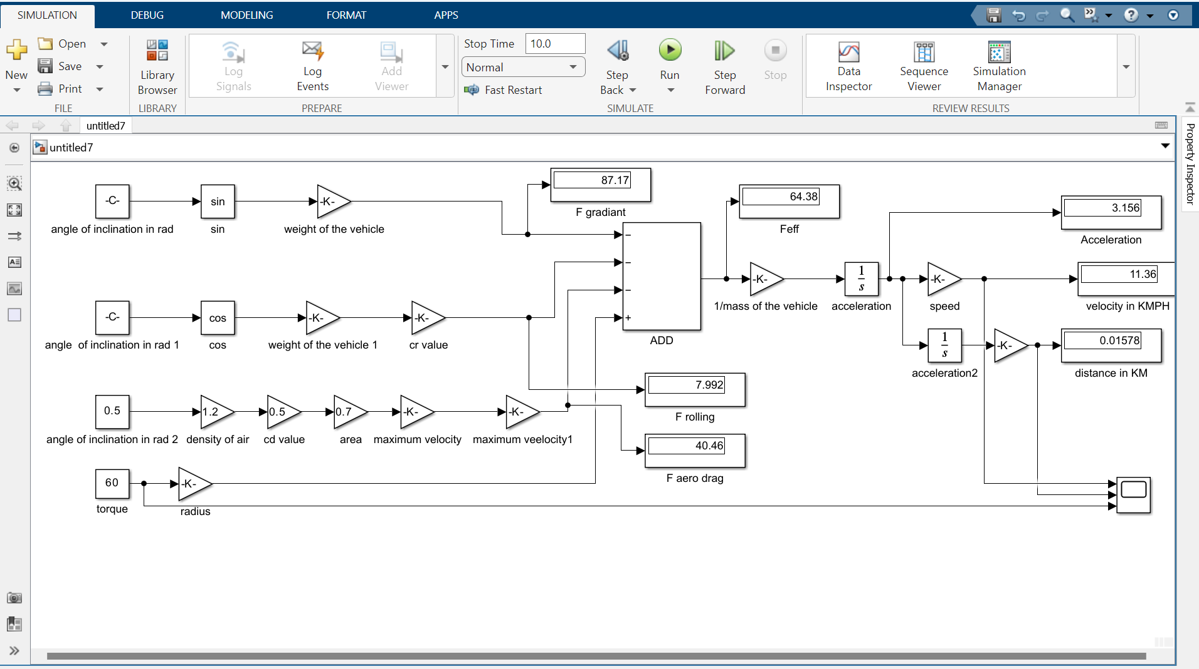
SIMULINK MODEL

Slide 15
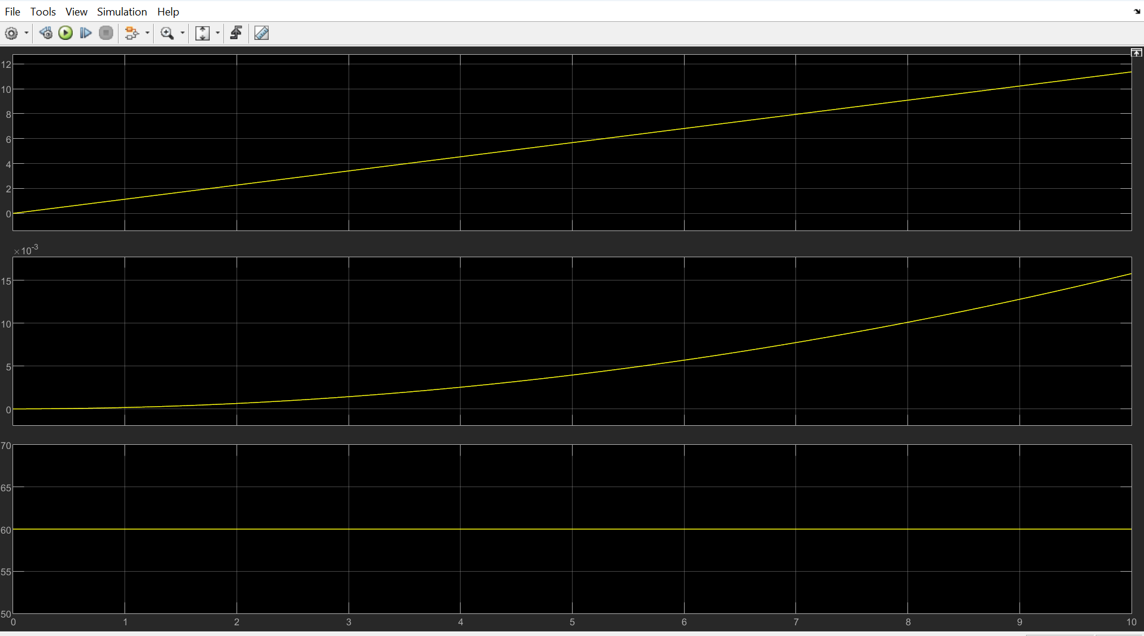
Output graph

Slide 16
VELOCITY(SPEED) AND DISTANCE:
The velocity of an hybrid electric vehicles (HEVs) is crucial for various aspects of its operation, including determining balance between electric and internal combustion engine power, optimizing fuel efficiency, and achieving desired performance characteristics.
In hybrid electric vehicle (HEVs), velocity refers to the speed or rate of motion of the vehicle, just like in any other vehicle. The formula for HEV:
Velocity(v): Change in position(x) / change in time(t)
In HEVs, distance refers to the extent or length the vehicle travels from one point to another. The formula to calculate distance is the same as in classical mechanics:
Distance(d)=Velocity(v)×Time(t)
Where:
Distance (d) is in units like kilo meters (km) or miles (mi).
Velocity (v) is the speed of the HEV in units like kilo meters per hour (km/h) or miles per hour (mph).
Time (t) is the duration of travel in hours.

Slide 17
AREAS OF FOCUS
Focus on Electric Vehicle Dynamics
Integration of Real-World Data
Performance Metrics and Analysis
Idealized Motor Characteristics
Validation Dependency on Data Availability
Integration of Advanced Motor Control Strategies
Generalization to Specific Electric Vehicle Models
Expansion to Multi-Motor Configurations

Slide 18
conclusion
Summary of Findings: Summarize the key findings from the results and analysis section.
Highlight the main outcomes related to motor torque, acceleration, velocity, and distance travelled.
Contributions to the Field: Discuss the contributions of your study to the field of electric vehicle dynamics and performance analysis. Emphasize how the findings can inform future research and development in the electric vehicle industry.
Implications for Electric Vehicle Design: Provide insights into how the study's results may have implications for the design and optimization of electric vehicles, especially in terms of motor torque control and overall performance.
Closing Remarks: Conclude the results and analysis section with closing remarks, summarizing the significance of the study's outcomes and their potential impact on the broader context of electric vehicle research.

Slide 19
THANK YOU

